Slide 1
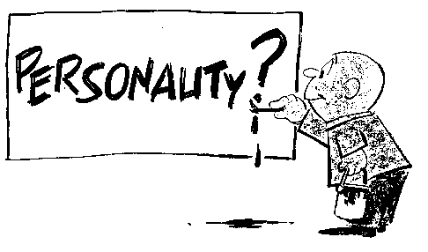
Personality
Part I – Introduction & Main Theories

Slide 2
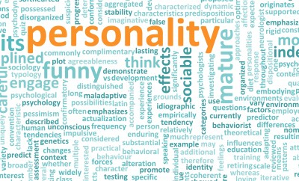
Personality
The psychological qualities that bring a consistency to an individual’s thoughts and behaviors in different situations and at different times
A continuously changing process, shaped by our individual needs and cognitions and by external pressures from the social environment

Slide 3
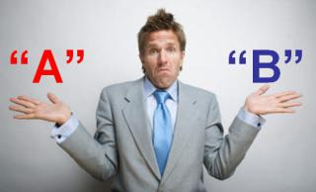
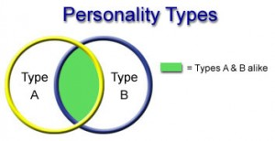
Personality
Type A vs. Type B
Generic description of our personalities
No research based theories
Most individuals have a combination of both types mixed throughout their specific personalities

Slide 4
Personality
Type A Traits
Generally has a higher stress level
Enjoy achievement of goals, with greater enjoyment in achieving of more difficult goals. They are thus constantly working hard to achieve these.
Find it difficult to stop, even when they have achieved goals
Feel the pressure of time, constantly working flat out
Highly competitive and will, if necessary create competition
Hate failure and will work hard to avoid it
Type B Traits
Generally lives at a lower stress level
Work steadily, enjoying achievements but not becoming stressed when they are not achieved.
When faced with competition, they do not mind losing and either enjoy the game or back down
May be creative and enjoy exploring ideas and concepts
Are often reflective, thinking about the outer and inner worlds

Slide 5
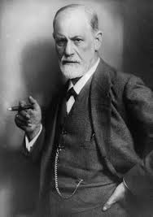
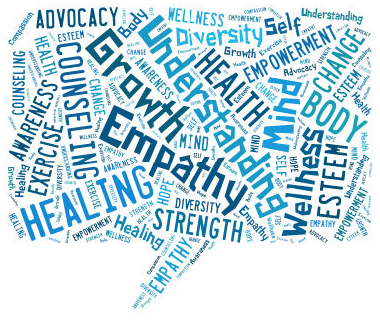
Personality
Main Theories
Psychodynamic Theory
Developed by Sigmund Freud
Calls attention to motivation, especially unconscious motives, and the influence of our past experiences
Humanistic Theory
Emphasizes the present, “subjective reality”
What we believe is important now
what we think of ourselves in relation to others

Slide 6
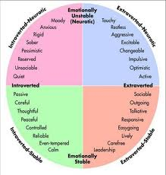
Personality
Main Theories
Social Cognitive Theory
Derived more from experiments rather than clinical work
Based on the idea that personality is a result of learning, perception and social interaction
Trait Theory
A theory that suggests our personalities are composed of various fundamental personality dimensions

Slide 7
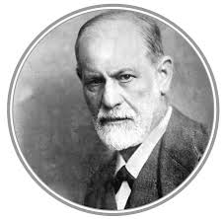
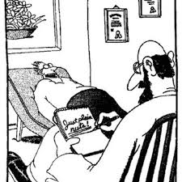
Personality
Psychodynamic Theory
Freud believes that the unconscious and hidden parts of the mind were a source of powerful impulses, instincts, motives, and conflicts that energize our personality
Developed this theory through psychoanalysis
Focused on how the mind’s energy is exchanged, transformed, and expressed

Slide 8
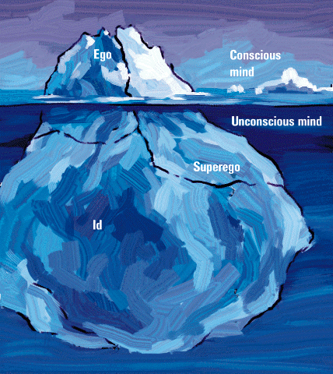
Personality
Freud saw human personality as an iceberg with three parts: The Ego, Superego and Id.
In this model, the Superego and the Id were antagonist parts, regulated by the Ego.
Ego
Conscious Mind
Unconscious
Mind
Superego
Id

Slide 9
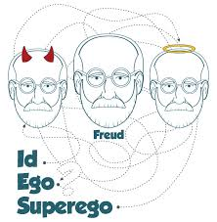
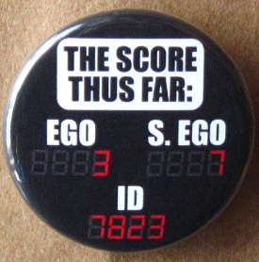
Personality
Psychodynamic Theory
The Id
The primitive, unconscious reservoir that houses the basic motives, drives and instinctive desires that determine our personalities.
Always acts on impulse and seeks immediate pleasure
The only part of the personality present at birth

Slide 10
Personality
Psychodynamic Theory
The Superego
The “police” of personality and is responsible for morals and values learned from society.
Develops as a child when we form an internal set of rules based on external experiences
The inner voice of “Should” and “Should Not”
Often conflicts with the id because the id wants what feels good and the superego wants what is right and moral

Slide 11
Personality
Psychodynamic Theory
The Ego
The conscious, rational part of the mind
Regulates the conflict between the id and the superego
Must figure out a way to satisfy one’s desires, while not violating one’s moral code.
When this balance becomes upset, conflicted thoughts and behaviors that signify a mental disorder may be the result

Slide 12
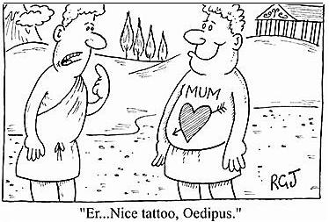
Personality
Part II – Psychosexual Stages &
Defense Mechanisms

Slide 13
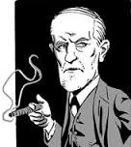
Personality
Psychosexual Stages
Freud believed that our early experiences stayed with us and affected us throughout our development, especially with regards to sex
Should something happen in the early years, people will have problems to overcome later in life specifically dealing with sexuality:
Oedipus Complex: Boy in love with their mother
Identification: Boys love their mom/identify with their dad
Penis Envy: Girls desire to have a penis-attracted to males
Fixation: Occurs when development is stopped at a particular stage

Slide 14
Personality
Psychosexual Stages
Psychosexual Stage | Focus
Oral (0-18 Months) | Pleasure centers on the mouth – sucking, biting, chewing
Anal (18-36 Months) | Pleasure focuses on bowel and bladder elimination; Coping with demands for control
Phallic (3-6 Years) | Pleasure zone is the genitals; Coping with incestuous sexual feelings
Latency (6 to Puberty) | Dormant sexual feelings
Genital (Puberty On) | Maturation of sexual interests

Slide 15
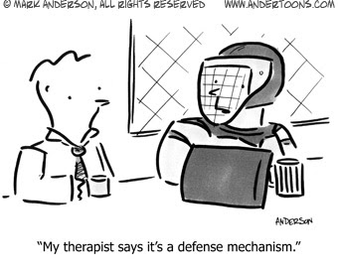
Personality
Ego Defense Mechanisms
Ego defense mechanisms are the largely unconscious mental strategies to reduce anxiety or conflict
In other words, our unconscious mind develops strategies to deal with threatening thoughts, memories, etc.

Slide 16
Defense Mechanism | Description | Example
Denial | Arguing against an anxiety provoking stimuli by stating that it doesn’t exist | Denying that your physician’s diagnosis of cancer is correct and seeking a second opinion
Displacement | Taking out impulses on a less threatening target | Slamming a door instead of hitting a person, yelling at your spouse after an argument with your boss
Intellectualization | Avoiding unacceptable emotions by focusing on the intellectual aspects | Focusing on the details of a funeral as opposed to the sadness and grief
Projection | Placing unacceptable impulses in yourself onto someone else | When losing an argument, you state “You’re stupid”
Rationalization | Supplying a logical or rational reason as opposed to the real reason | Stating that you were fired because you didn’t kiss up to the boss, when the real reason was your performance

Slide 17
Defense Mechanism | Description | Example
Reaction Formation | Taking the opposite belief because the true belief causes anxiety | Having a bias against a particular race or culture and then embracing that race or culture to the extreme
Regression | Returning to a previous state of development | Sitting in a corner and crying after hearing bad news; throwing a temper tantrum when you don’t get your way
Repression | Pulling into the unconscious | Forgetting sexual abuse from your childhood due to the trauma and anxiety
Sublimation | Acting out unacceptable impulses in a socially acceptable way | Becoming a surgeon because of your desire to cut; lifting weights to release ‘pent up’ energy
Suppression | Pushing into the unconscious | Trying to forget something that causes you anxiety

Slide 18
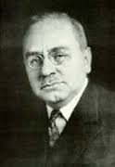
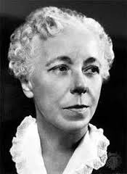
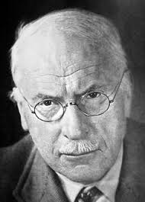
Personality
Neo-Freudians
Freud was a controversial figure, and many of his collogues broke away from his view, but still maintained a psychodynamic aspect to their theories
Alfred Adler
Importance of childhood social tension
Karen Horney
Sought to balance Freud’s masculine biases
Carl Jung
Emphasized the “Collective Unconscious”
Concept of a shared, inherited reservoir of memory traces from our species’ history

Slide 19
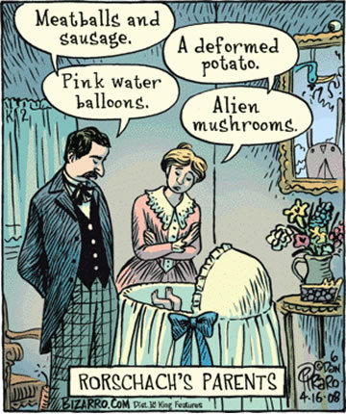
Personality
Part III – Assessing the Unconscious

Slide 20
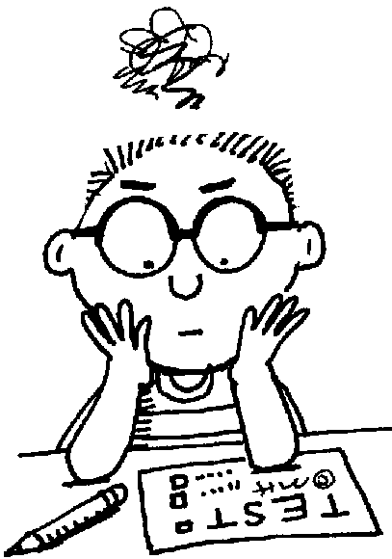
Personality
Freud and Neo-Freudians determined that certain tests needed to be created in a way that would help to “project” what was present in the unconscious

Slide 21
Personality
Projective Test
A personality test that provides ambiguous stimuli designed to trigger projection of one’s inner dynamics
Two Most Popular:
Thematic Apperception Test (TAT)
Rorschach’s Inkblot Test

Slide 22
Personality
Thematic Apperception Test (TAT)
A projective test in which people express their inner feelings and interests through the stories they make up about ambiguous scenes
Giving the subject a picture that is ambiguous (can have several meanings) and ask them what is occurring.
Their answers supposedly reveal their unconscious

Slide 23
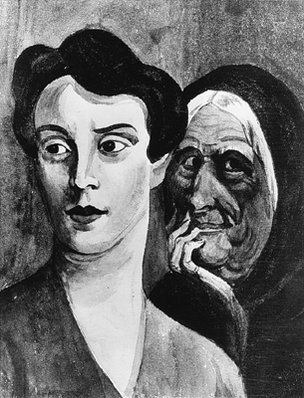

Slide 24
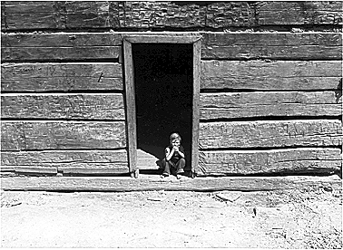

Slide 25
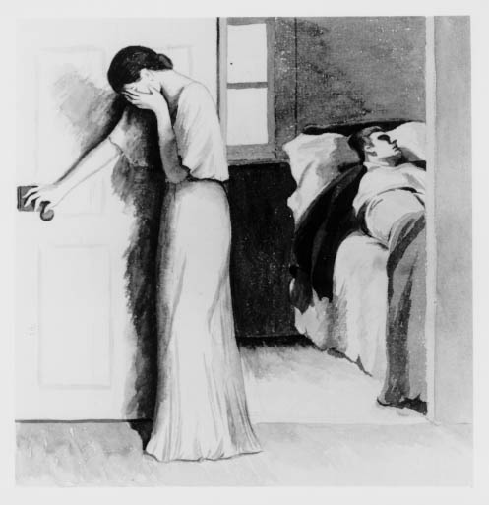

Slide 26
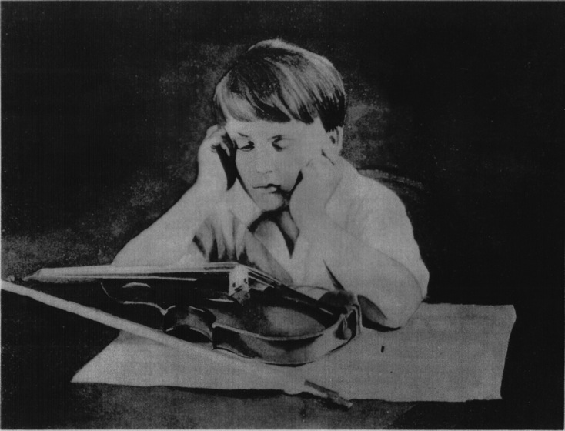

Slide 27
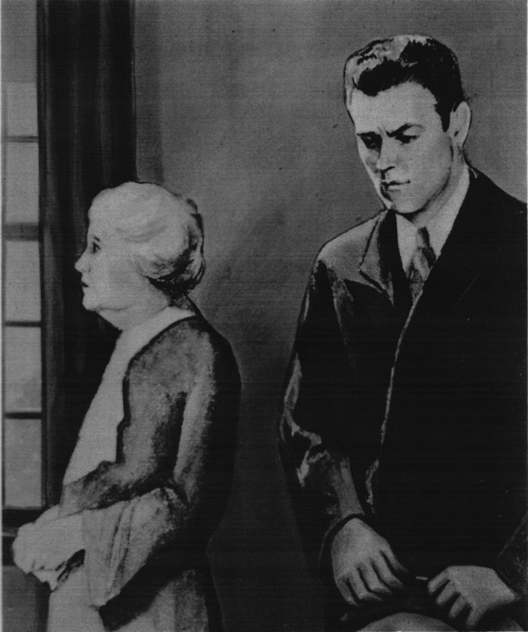

Slide 28
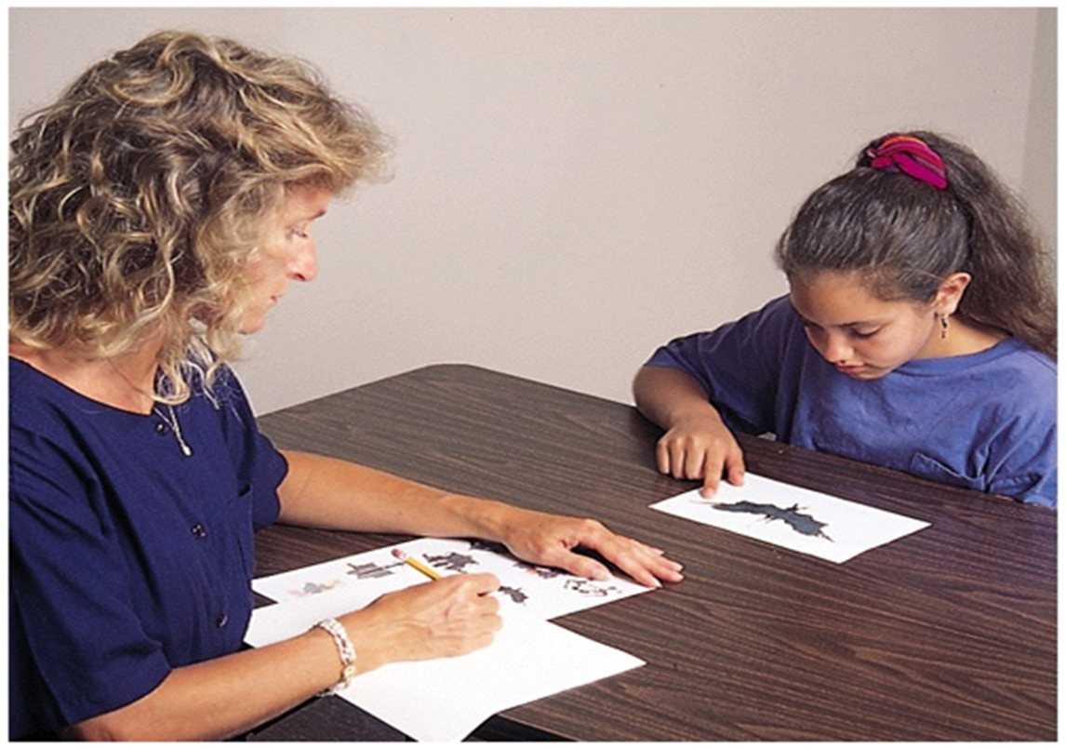
Personality
Rorschach Inkblot Test
Designed by Hermann Rorschach
The most widely used projective test
A set of 10 inkblots that seek to identify people’s inner feelings by analyzing their interpretations of the blots

Slide 29
Personality
Part IV – Humanistic &
Social Cognitive Theories

Slide 30
Personality
Humanistic Theories
Humanistic theories are optimistic about the core of human nature
Personality is driven by needs to adapt and learn, rather than unconscious conflicts or defense mechanisms and anxiety
Mental disorders occur when a person is in an unhealthy situation that causes low self-esteem and unmet needs, not from unhealthy individuals

Slide 31
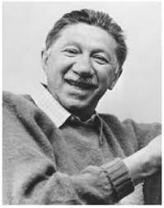
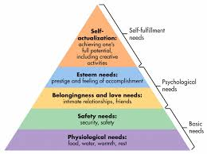
Personality
Abraham Maslow
Hierarchy of Needs
Believed psychology needed something that described good mental health as more than just the absence of illness
Maslow saw a group of people in pursuit of “higher ideals” and wanted a way to explain their behavior.
Self-Actualizing Personalities - Healthy individuals who have met their basic needs and are free to be creative and fulfill their potentialities

Slide 32
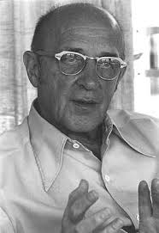
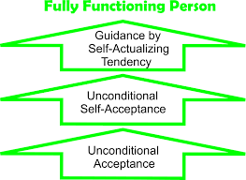
Personality
Carl Rogers
Took a different approach than Maslow
He identified healthy personalities as the fully functioning person
An individual who has a self-concept that is positive and congruent with reality

Slide 33
Personality
Carl Rogers
“Self”
Each person has this
How we see ourselves
“Conditions of Worth”
Love and approval based on doing what someone else likes
Can lead us to deny parts of ourselves
“Unconditional Positive Regard”
Being valued for exactly what you are
“Fully Functioning”
Not denying who we truly are
Fully accepting all of our potential

Slide 34
Personality
Criticisms of Humanistic Theories
Concepts are vague and subjective
Can lead to self-indulgence, selfishness, and erosion of morals
Fails to appreciate the human capacity for evil
Others?

Slide 35
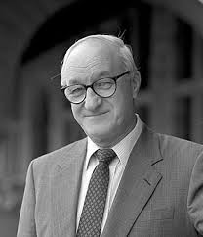
Personality
Social Cognitive Theory
More of an emphasis on clinical research than other theories
Most well known: Albert Bandura
Observational Learning & Bobo the Clown!
Believed we are driven by:
Inner forces and the environment
Expectations about how those actions will affect other people, the environment, and ourselves.

Slide 36
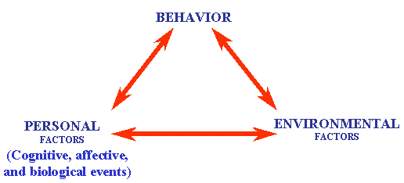
Personality
Social Cognitive Theory
Observational Learning
We learn new responses by watching each others’ behavior
Therefore, personality is learned behavior patterns
These cognitive process involve an ongoing relationship between the individual and the environment called “Reciprocal Determinism”

Slide 37
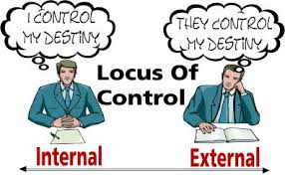
Personality
Social Cognitive Theory
Locus of Control
Our sense of controlling our environments rather than feeling helpless
External Locus of Control
The perception that chance or outside forces beyond one’s control determine their fate
Internal Locus of Control
The perception that one controls one’s own fate

Slide 38
Personality
Criticisms of Social Cognitive Theory
Ignores heredity, emotion, and past experiences
Lacks attention to biological/hormonal processes in regards to personality
Concepts and processes are observable but very few explanations about relationships between them

Slide 39
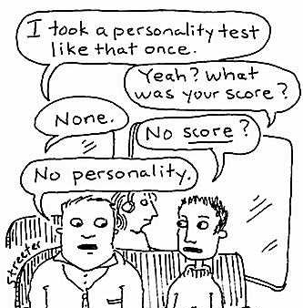
Personality
Part V – Trait Theories

Slide 40
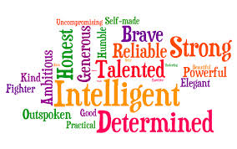
Personality
Traits
Stable personality characteristics that are presumed to exist within the individual
These also guide his or her thoughts and actions under various conditions
Examples:
Honest
Dependable
Moody
Impulsive
Allport & Odbert (1936) identified over 18,000 words representing personality traits

Slide 41
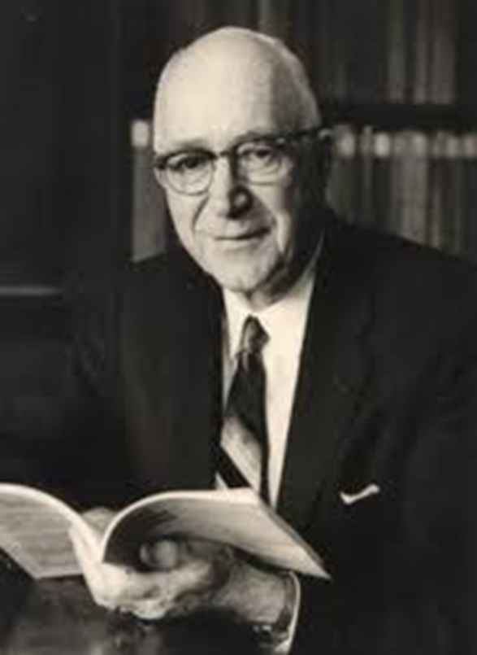
Personality
Traits
Allport’s Hierarchy of Traits
Cardinal Traits
Pervasive characteristics that influence behavior
Very few possess such dominant traits
Central Traits
Basic building blocks of personality that influence behavior
Secondary Traits
Superficial characteristics, such as personal preferences

Slide 42
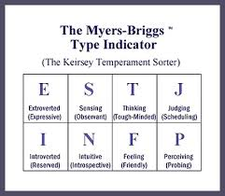
Personality
Personality “Types”
Assessed by measures like the Myers-Briggs Type Indicator
Consist of a number of traits
Examples:
Feeling Type - Personality is sympathetic, appreciative, and tactful
Thinking Type - Prefers an “objective standard of truth” and is “good at analyzing”

Slide 43
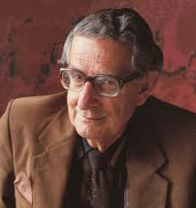
Personality
Personality “Dimensions”
Hans and Sybil Eysenck suggested that personality could be reduced down to two polar dimensions:
Extraversion-Introversion
Emotional Stability-Instability
Believed that most personality traits, characteristics, etc. fall somewhere between these dimesnions

Slide 44
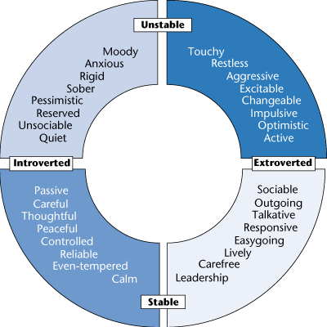

Slide 45
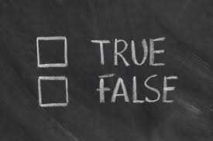
Personality
Personality Inventory
A questionnaire on which people respond to items designed to gauge a wide range of feelings and behaviors
Often consist of true-false or agree-disagree items
Used to assess selected personality traits

Slide 46
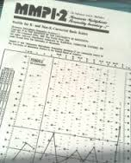
Personality
MMPI
The Minnesota Multiphasic Personality Inventory (MMPI)
Most widely researched and clinically used of all personality tests
Was originally developed to identify emotional disorders
Problems:
Meaning attached to items may be misinterpreted
Good place to start with personality, but not a great measure by itself

Slide 47
Personality
The Five-Factor Theory
Suggests that personality is composed of five fundamental personality dimensions
Openness to experience
Conscientiousness
Extraversion
Agreeableness
Neuroticism

Slide 48
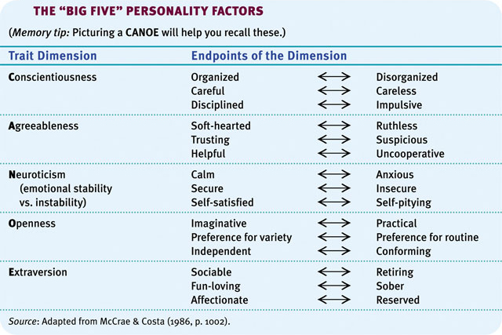

Slide 49
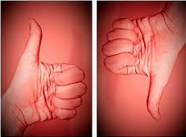
Personality
Positives & Negatives
Positives:
Objective and measurable
Easy to use and understand
Negatives:
Little predictive power
Does not address personality development (only present)
Does not allow for or help with change

