Slide 1
THE ROLE OF GOVERNMENT & THE BUSINESS CYCLE
CHAPTER 23, SECTIONS 1 & 2

Slide 2
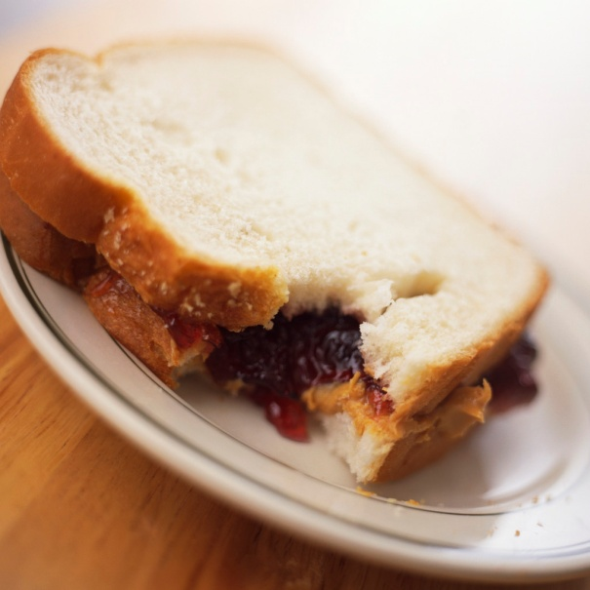
PRIVATE GOODS
Private goods – can only be consumed by one person
Private goods are subject to the exclusion principle – a person is excluded from using the good unless they pay for it

Slide 3
PUBLIC GOODS
Public goods – goods that can be consumed by one person without preventing another from consuming
Subject to the nonexclusion principle – no one can be excluded from consumption whether they pay or not

Slide 4
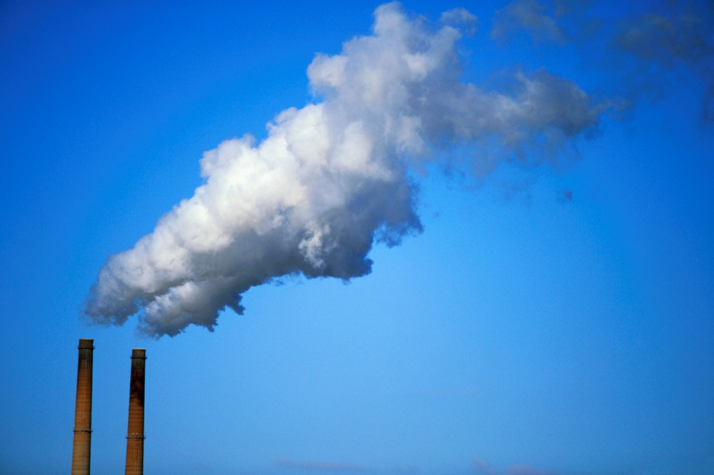
DEALING WITH EXTERNALITIES
Gov’t plays a role in handling externalities – the unintended side effect of an action that affects someone not involved in the action (these can be positive or negative)

Slide 5
MAINTAINING COMPETITION
Gov’t uses antitrust laws to prevent monopolies (only one provider of a good or service) and preserve and promote competition
Why? Competition ensures better quality
Gov’t oversees mergers – a combination of two or more companies to form a single business

Slide 6
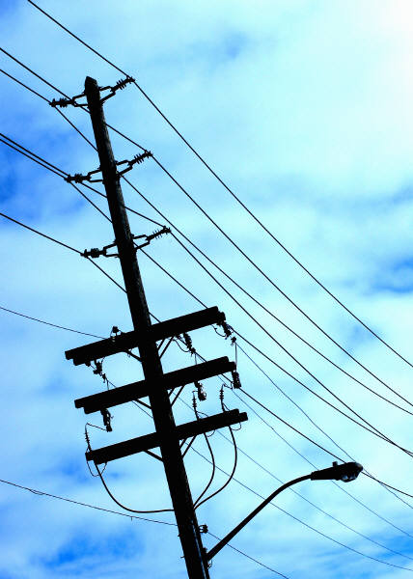
REGULATING MARKET ACTIVITIES
Sometimes it makes sense to have a monopoly → natural monopolies – a market situation in which the costs of production are minimized by having a single firm produce a product

Slide 7
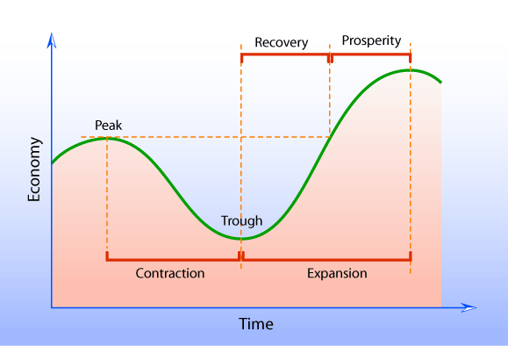
THE BUSINESS CYCLE

Slide 8
THE BUSINESS CYCLE - TERMS
Real GDP – an economy’s production after the distortions of price have been removed
Expansion – a period when RGDP goes up
Peak – the highest point in an expansion
Recession – a period when RGDP goes down for six straight months

Slide 9
THE BUSINESS CYCLE - TERMS
Trough – the lowest point during recession
Depression – when recession lasts for more than six straight months

Slide 10
THE BUSINESS CYCLE

Slide 11
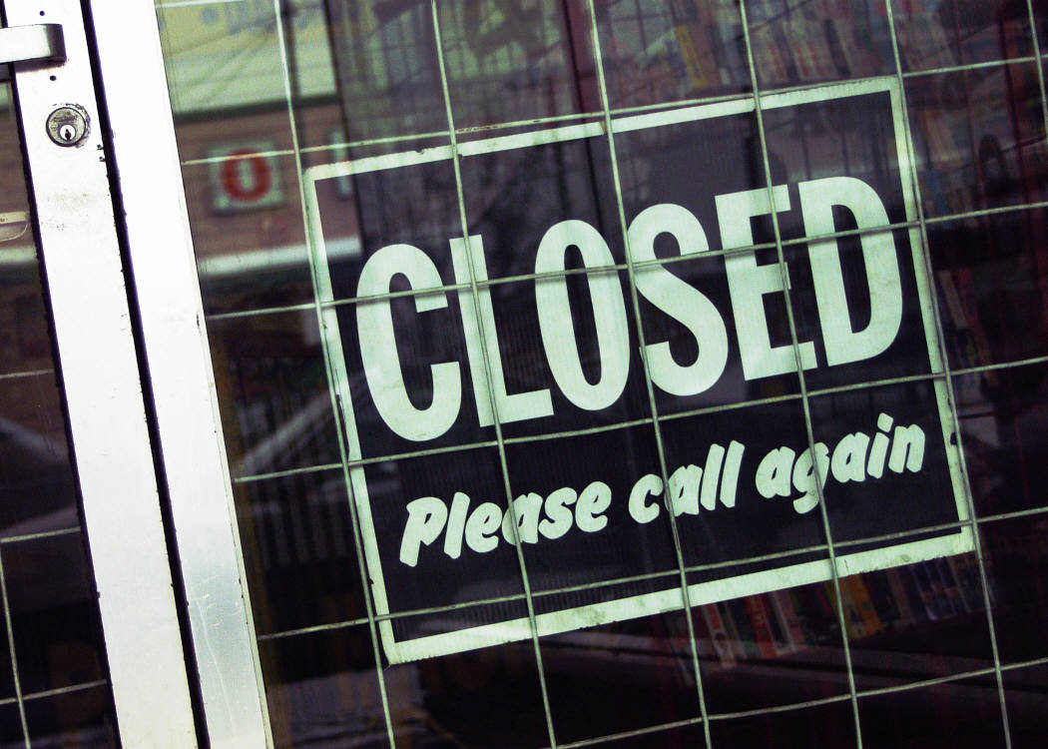
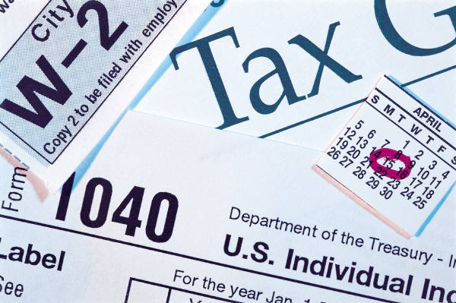
OTHER MEASURES OF THE ECONOMY
Unemployment rate – the %-age of the civilian labor force (all civilians 16 years old or older who are working or looking for work) who are not working but looking for work
Fiscal Policy – changes in gov’t spending and tax policy

Slide 12
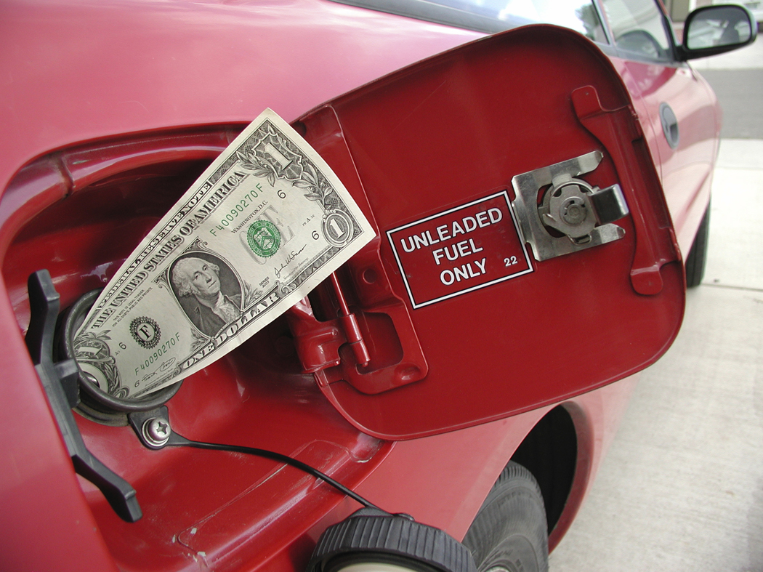
OTHER MEASURES OF THE ECONOMY
Inflation – a sustained increase in the general level of prices
To track inflation the gov’t uses the consumer price index (CPI) – a measure of the price level of 400 various products
Dividends – a share of the corporation’s profits distributed to shareholders
Capital gain – occurs when stock can be sold for more than it originally cost to buy

Slide 13
THE “THREE” TYPES OF BUSINESS
CHAPTER 22, SECTION 1

Slide 14
PROPRIETORSHIPS
The most common form of business organization in the U.S. is sole proprietorship – a business owned by a single person

Slide 15
PROPRIETORSHIPS
ADVANTAGES
Full pride in ownership
Make decisions quickly
Keep most of profits
DISADVANTAGES
Unlimited liability – financially responsible for all problems
Difficult to raise financial capital - $ needed to run a business or make it grow
Hard attracting qualified employees

Slide 16
PARTNERSHIPS
Partnership – a business owned by two or more people
Articles of partnership – legal agreement to start a partnership

Slide 17
PARTNERSHIPS
ADVANTAGES
Partners can usually raise $ easier or take on new partners to raise more $
Each partner brings special talents
DISADVANTAGES
The legal structure is complex → the articles of partnership have to be renewed when they take a new partner
Unlimited liability

Slide 18
CORPORATIONS
Corporation – business recognized by law that has many of the rights and responsibilities of an individual (own property, pay taxes, sue or be sued)

Slide 19
CORPORATIONS
To start a corporation you must get a charter – gov’t document granting permission to organize
The owners of a corporation are its STOCKHOLDERS!
Stock – ownership shares of a corporation

Slide 20
CORPORATIONS
ADVANTAGES
Easy to raise financial capital
Corporations are huge
Board of directors (run the company on the stockholder’s behalf) can hire professional managers
Ownership of corporations can be easily transferred
Limited liability – only the corporation, not its owners, are responsible for the debts of the corporation
DISADVANTAGES
Expensive and complex to set up
Owners have little say in the management of the corporation
Subject to more gov’t regulation
Stockholders are subject to double taxation – paying taxes twice on corporate profits

Slide 21
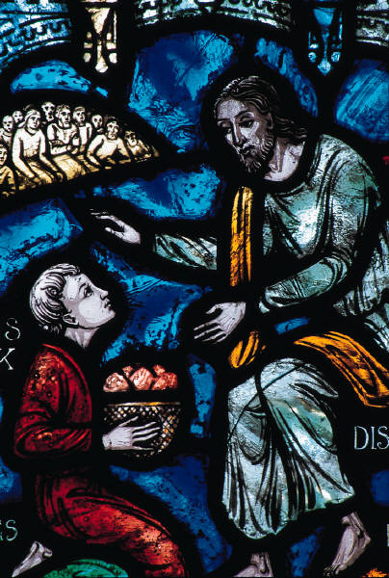
NON-PROFIT ORGANIZATIONS
Non-profits are just what their title suggests → businesses who are not driven by the profit motive
Examples include churches, museums, schools, etc.

